Slide 1


Data Analysis of Historical Stock Data
TEAM#4
Fadi Tabet
Vandana Iyer
Omkar Daphal

Slide 2

PROJECT GOAL
Project goal is to build a resilient and high efficient Scala/Spark application that is able to parse & analyze big records of financial stock data to provide meaningful and accurate analysis result and prediction.

Slide 3
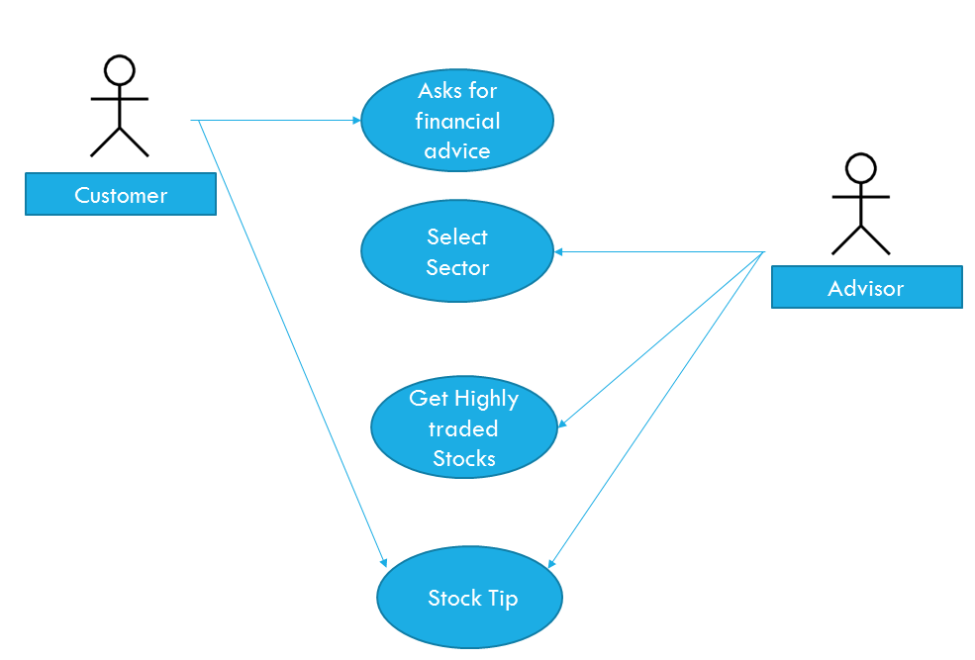
GENERAL USE CASE

Slide 4

METHODOLOGY: PHASE 1
Collecting Stock Data from ‘Yahoo Finance’ on the fly using their API.
Data Collected Specification:
EOD Stock Data for 10 Years.
5 Major Sectors (Computer & Technology, Finance, Retail, Industrial & Medical).
Each sector contains data related to 5 different companies.

Slide 5

METHODOLOGY: PHASE 2
2. Filtering and Grinding of Data Collected.
This Phase is Done Using SCALA:
Sorting each company by sector.
Mapping stock data to a data model.
Applying unit test to maintain stable behavior of each code block.
Feed data into spark.

Slide 6

METHODOLOGY: PHASE 3
3. Performing Insightful Financial Analysis on Collected Data.
This Phase is Done using SPARK:
Earning for each company per day.
High & Low Companies by Volume per day.
Company performance over time.
Company VS Company performance.
Company VS Sector performance.
Sector VS Sector performance.
Grading & Ratio per company & sector.

Slide 7

METHODOLOGY: PHASE 4
4. Displaying Result & Prediction.
Based on Data Collected & Analyzed:
Display result of analysis in a Web UI.
Generating a short term prediction for each company & sector based on the highs and lows of a stock(Ex: Using Linear Regression we can predict the next day high/low based on previous day).

Slide 8

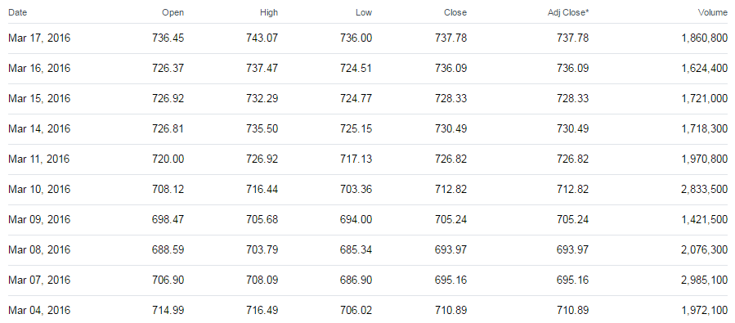
THE DATA SOURCE (~70,000 rows)
10 years of stock data (open, high, low, close and volume) for 5 companies in 5 different sectors received from Yahoo Financial API.
http://download.finance.yahoo.com/d/quotes.csv?s=%40%5EDJI,GOOG&f=nsl1op&e=.csv

Slide 9
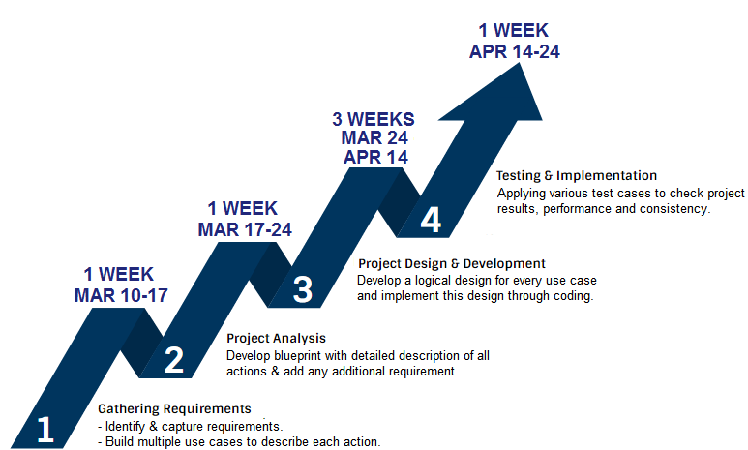
MILESTONES

Slide 10

GITHUB REPOSITORY
Contributions done by any team member will be posted/committed immediately to the project repo.
Daily repository backups will be performed.
https://github.com/tabet-f/Analysis-of-Historical-Stock-Data [LINK]

Slide 11

ACCEPTANCE CRITERIA FAIL OR PASS
Project is delivered on time.
Project deliverable is ~ error free.
Project meets all requirements specified in “Requirements gathering & analysis steps”.
Project is documented.
Project KPI is close to popular benchmarks (Esignal, Ninjatrader…).
Project Scalability and Extensibility over different data sets (performance with data for 20 years x 20 companies x 20 sectors => ~2M+ Rows).

Slide 12

Thank
you

